Slide 1
CISC3003-Project-Assignment Individual Part: Implementing a Simple Shopping Cart System with PHP PDO and MySQL Database
Huang Yanzhen, DC126732

Slide 2
Introduction
This project aims to implement a simple shopping cart system with the following functions
Adding products into Product View
Adding products listed in Product View into Shopping Cart
Alternatively, directly place an order in Product View
Placing an order in Shopping Cart
Alternatively, delete products in the Shopping Cart

Slide 3
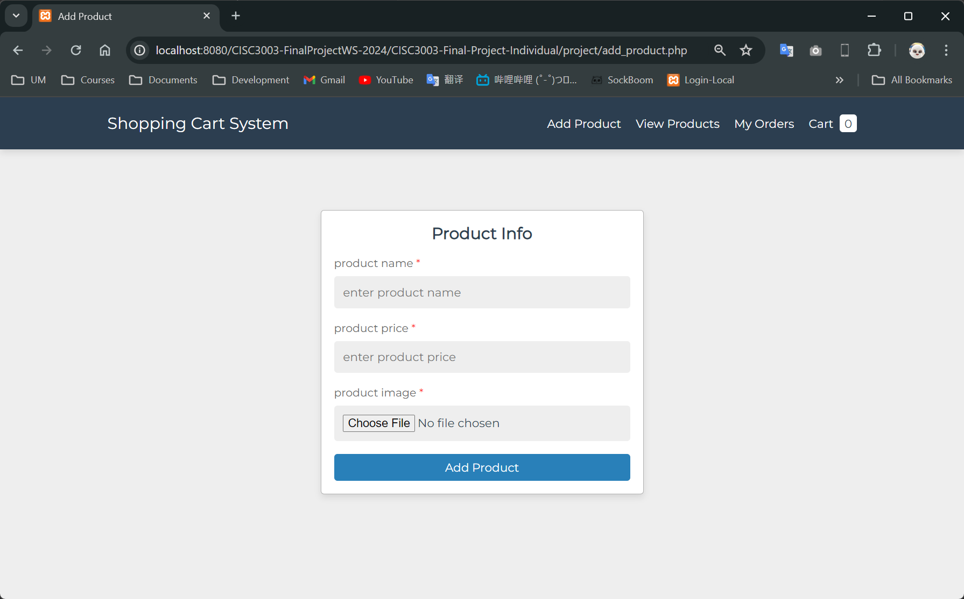
Functions / Add Product
To add a product, a user
Specifies the name of the product
Specifies the price of the product
Uploads the webp image file of the product

Slide 4
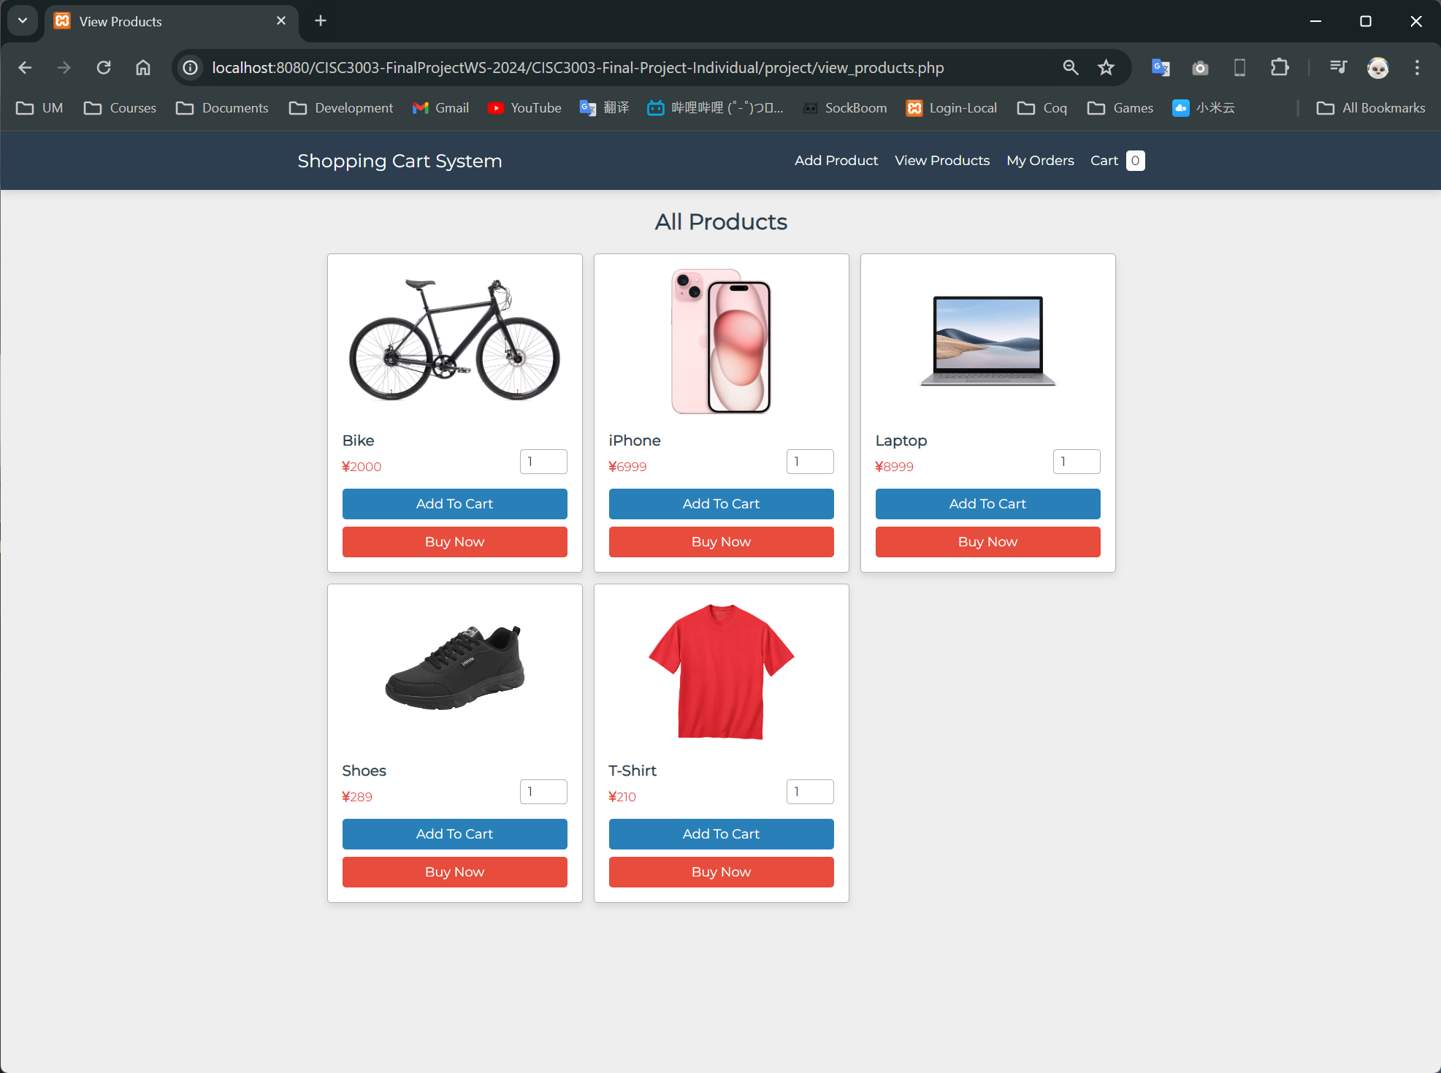
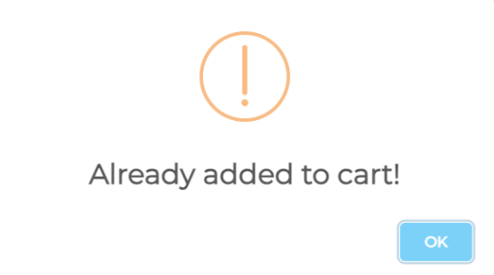
Functions / View Products
All the available products are listed in this page
A user can:
Specify the quantity of products he/she wants to buy
Add a product into shopping cart
Alternatively, directly place an order
Exception:
If the user tries to add a product that’s already in the shopping cart, an alert will be invoked.

Slide 5
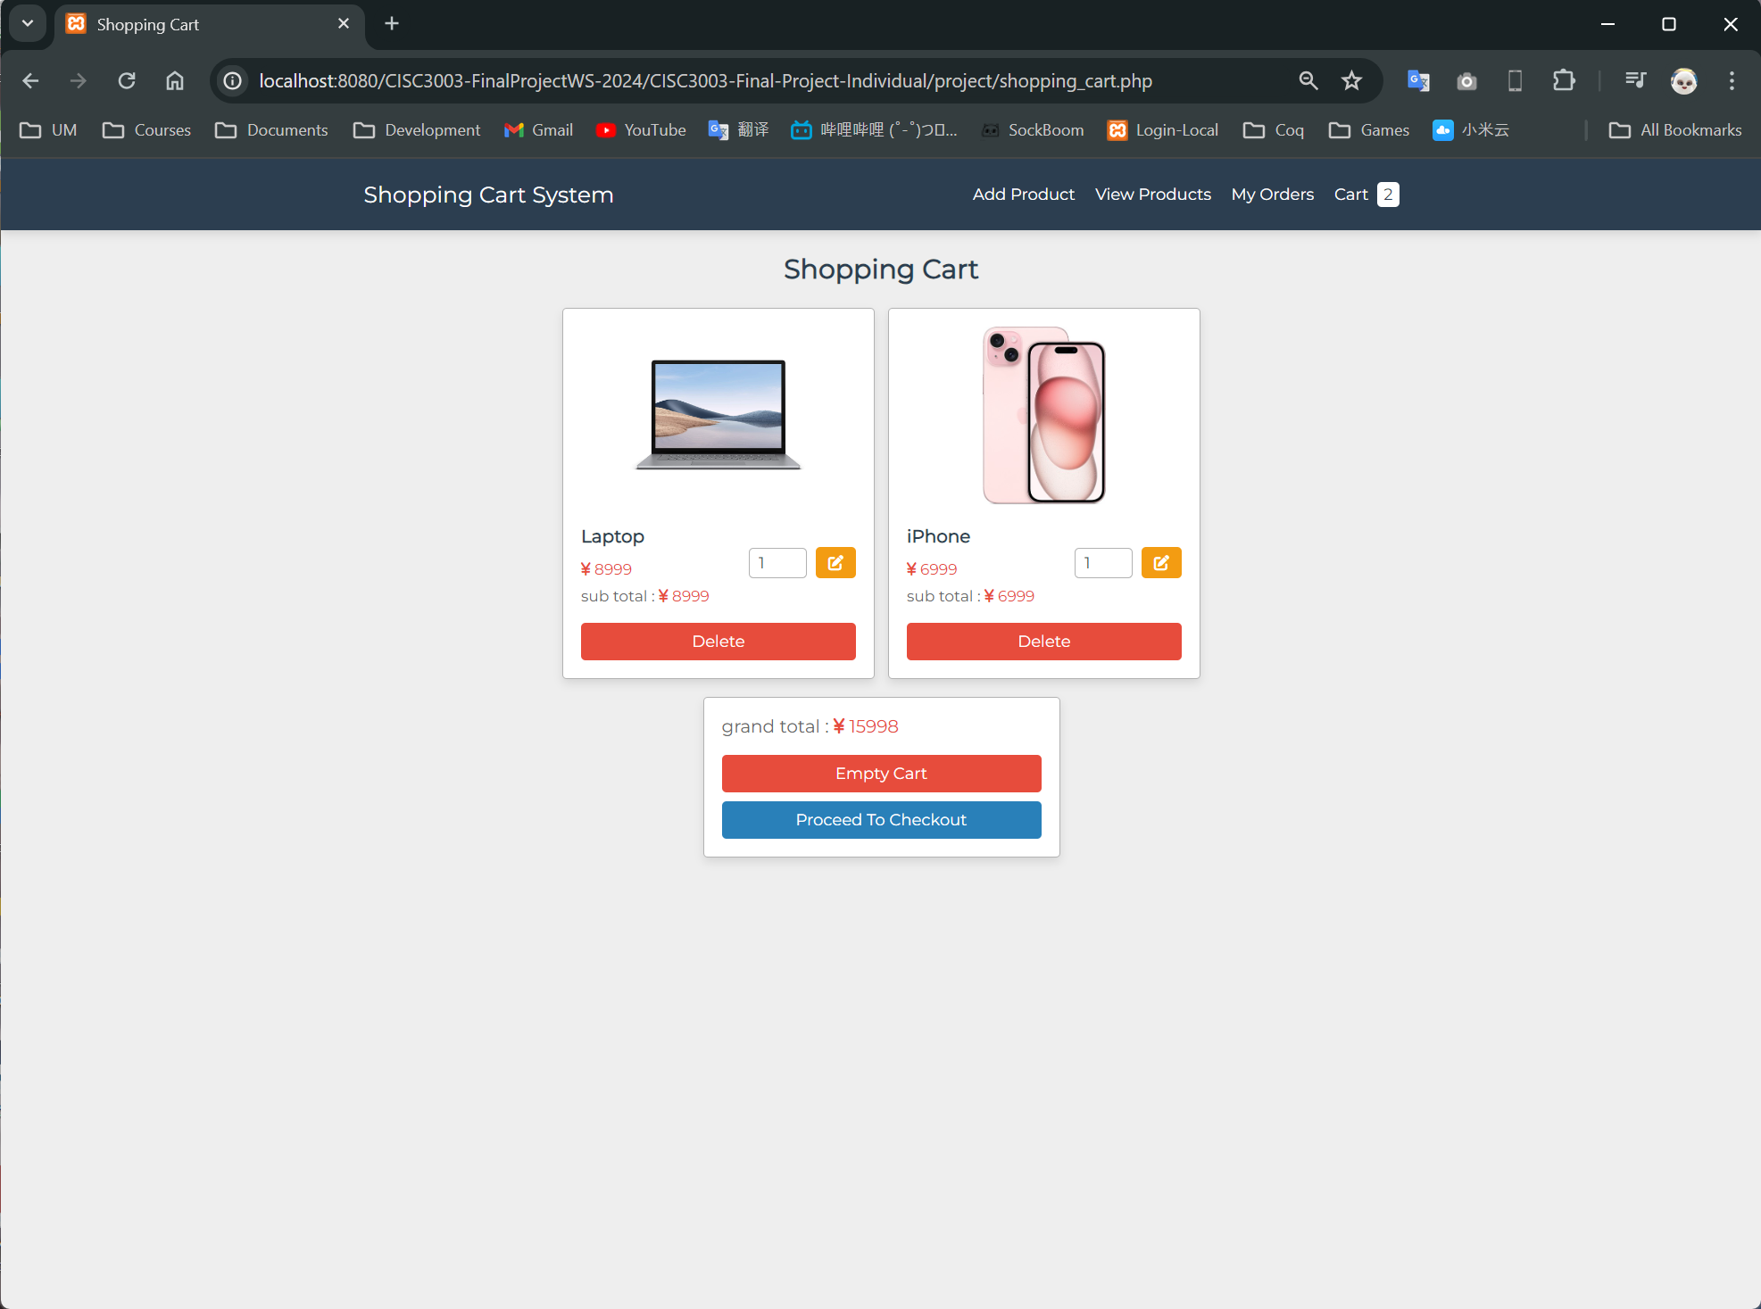
Functions / Shopping Cart
Shopping cart is a list of products a user decides to buy but didn’t buy immediately
A user can:
Remove the added product
Modify the quantity of a product
Empty the shopping cart
Proceed to make purchase

Slide 6
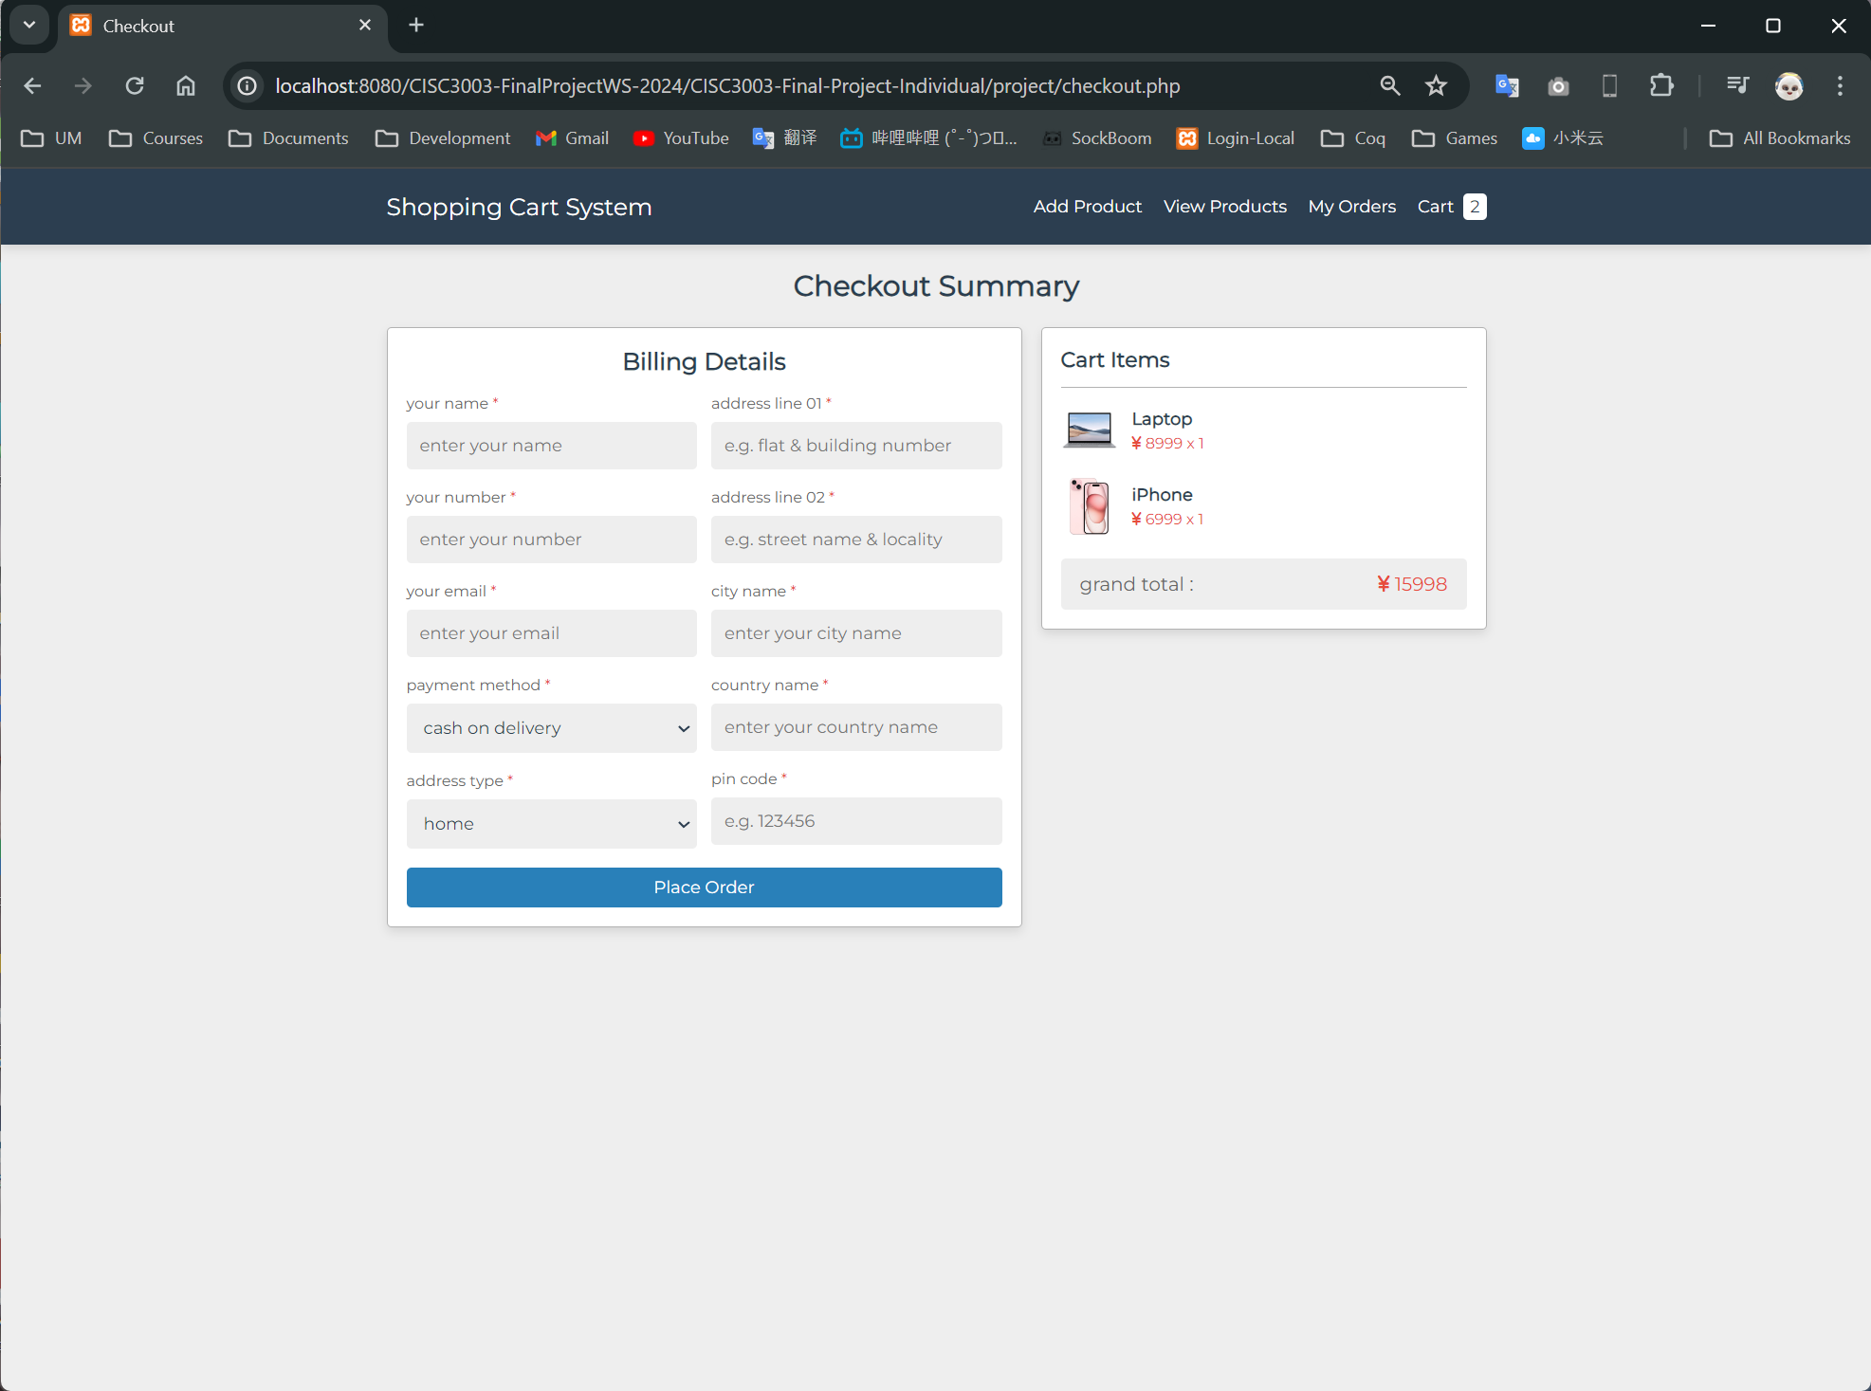
Functions / Checkout
A user places an order with detailed information in checkout
A user needs to specify:
Name
Addresses & Address Types
Phone number
Email
City & Country
PIN code

Slide 7
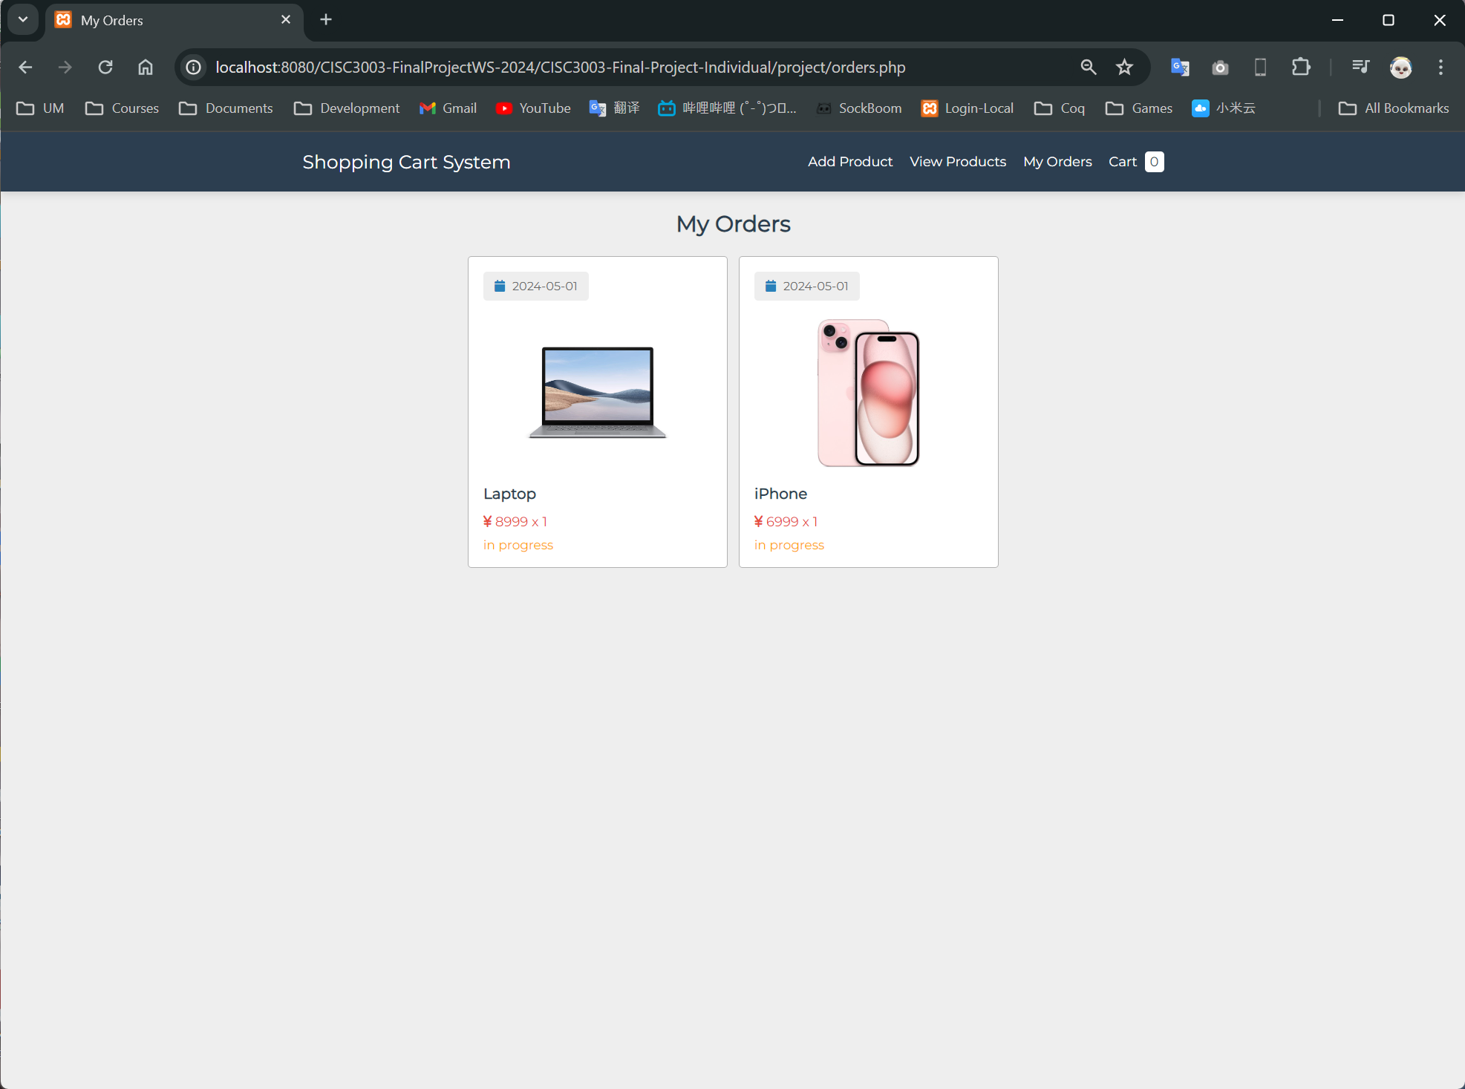
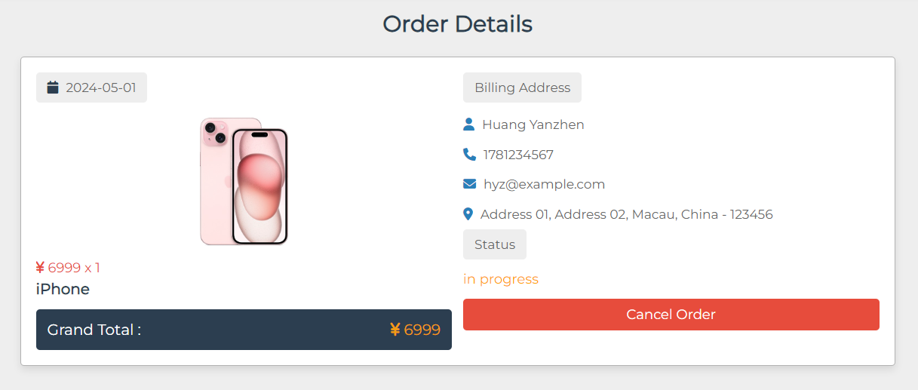
Functions / Orders
A user can view the orders they made in this page. Each product in the order have:
Date of purchase
Price
Order Status
By clicking into an order, a user can view the detailed information specified in checkout, as well as cancel the order.

Slide 8
Thanks for Watching!

